Slide 1

Regional Sales Analysis
(Using Python-EDA & Power BI)
- Riya Arora

Slide 2
Objective :
To analyze sales performance across products, customers, channels, and regions, identify key drivers of revenue and profitability, and build an interactive dashboard to support data-driven decision-making.

Slide 3
EDA (Charts and Insights)

Slide 4
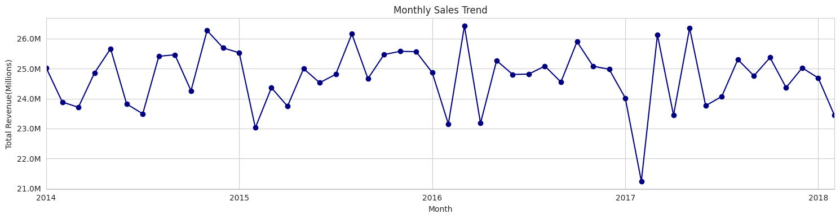
Monthly Sales Trend Over Time
Insights
Consistent sales cycle: $24M to $26M.
Seasonal peaks: Late spring/early summer (May-June).
Annual low: January.
Notable outlier: Sharp revenue drop in early 2017.

Slide 5
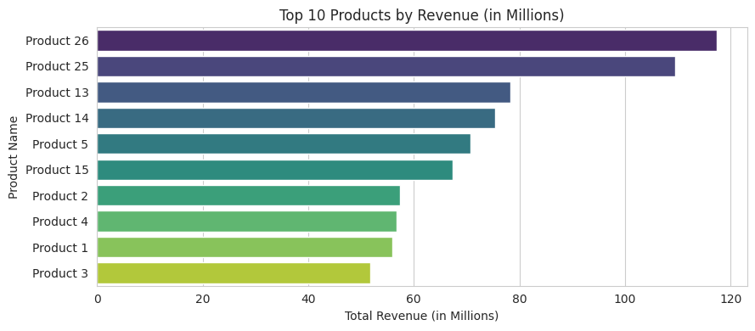
Top 10 Products by Revenue
Insights
Revenue leaders: Products 26 & 25 dominate.
Mid-range: Products 5, 13, 14, 15 show similar revenue.
Bottom cluster: Products 1, 2, 3, 4 have the lowest revenue.
Strategy: Grow mid-tier, improve lower performers.

Slide 6
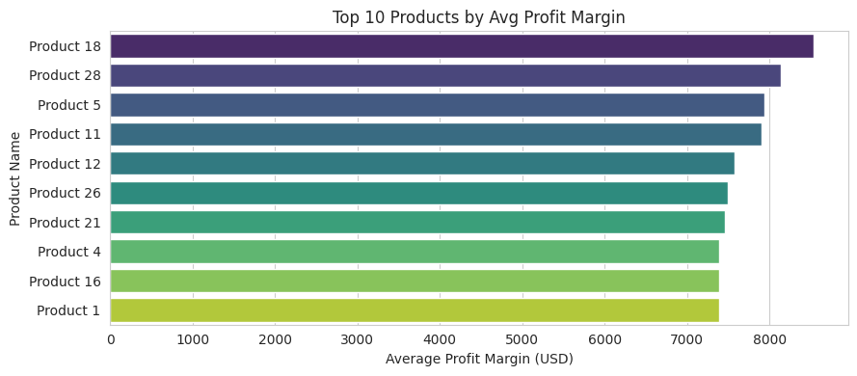
Top 10 Products by Average Profit Margin
Insights
Top: Products 18 & 28 lead at ~$8.1–8.4K.
Next tier: Products 5, 11, 12 & 26 at ~$7.5–7.8K.
Entry‑level: Products 1, 4, 16 & 21 around $7.3K.
Takeaway: Top 10 all exceed $7.3K—consistent high margins.

Slide 7
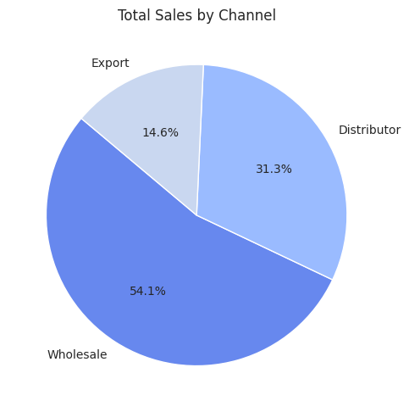
Total Sales by Channel
Insights
Wholesale dominates: Generates the majority of total sales at 54.1%.
Distributor is significant: Contributes a substantial 31.3% to total sales.
Export is a smaller portion: Accounts for 14.6% of the total sales.

Slide 8
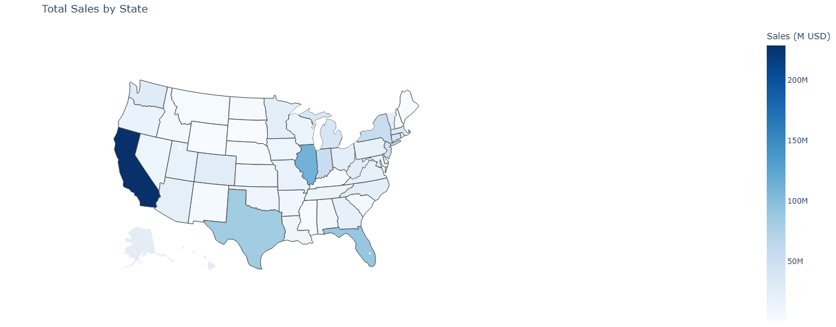
Total Sales by State (Choropleth Map)
Insights
California leads: Highest total sales.
Texas, Florida, Illinois: Significant sales.
Varying sales: Other states show moderate to low sales.
Visual pattern: Higher sales in larger and some coastal states.

Slide 9
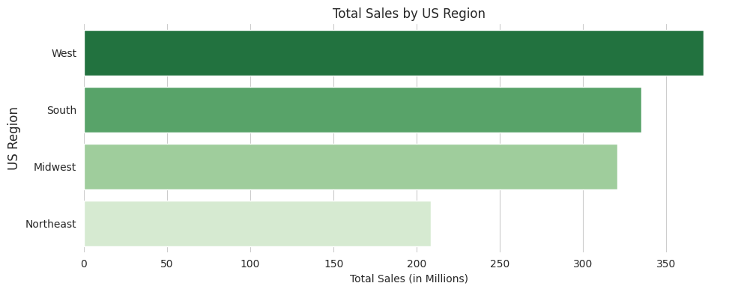
Total Sales by US Region
Insights
West: Highest sales, strong market influence.
South: Major sales contributor, key market area.
Midwest: Steady sales performance, moderate market size.
Northeast: Lowest sales, suggests need for deeper market understanding.

Slide 10
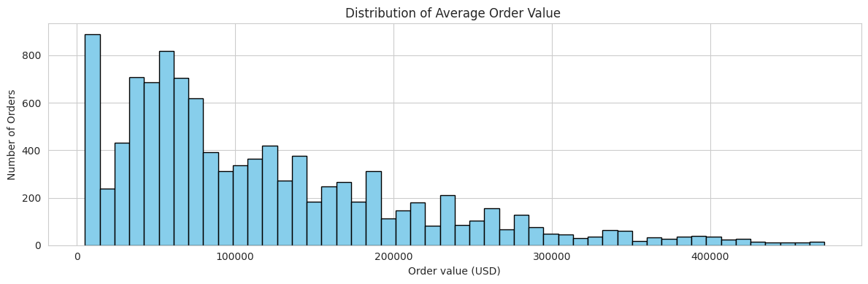
Average Order Value (AOV) Distribution
Insights
Low average order values are frequent.
Distribution is right-skewed (long tail of high-value orders).
Multiple order value clusters exist.
Higher order values are less common.

Slide 11
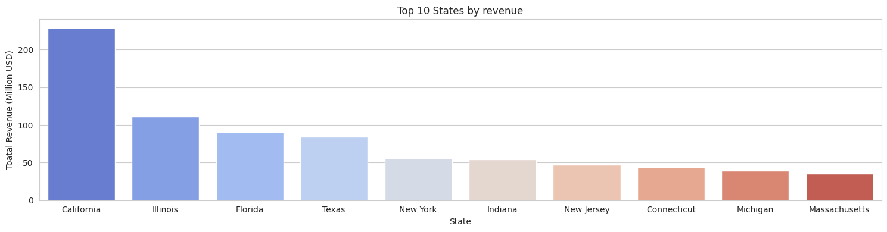
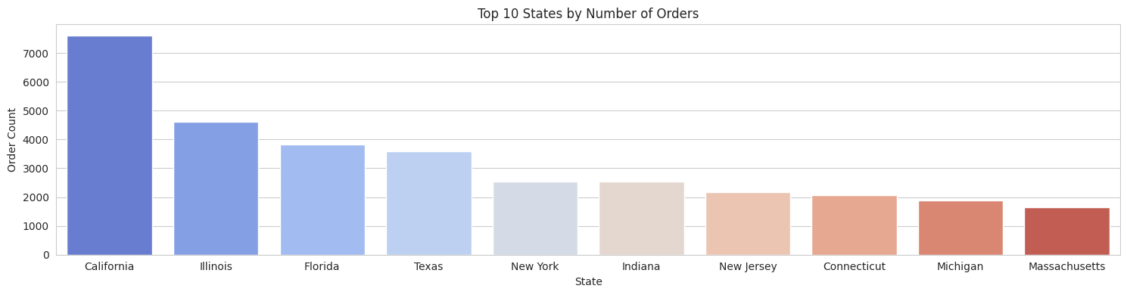
Top State Performance : Revenue vs. Orders
Insights
California tops revenue & orders.
IL, FL, TX: High in both.
Revenue & orders linked.
Other top states: Lower contribution.

Slide 12
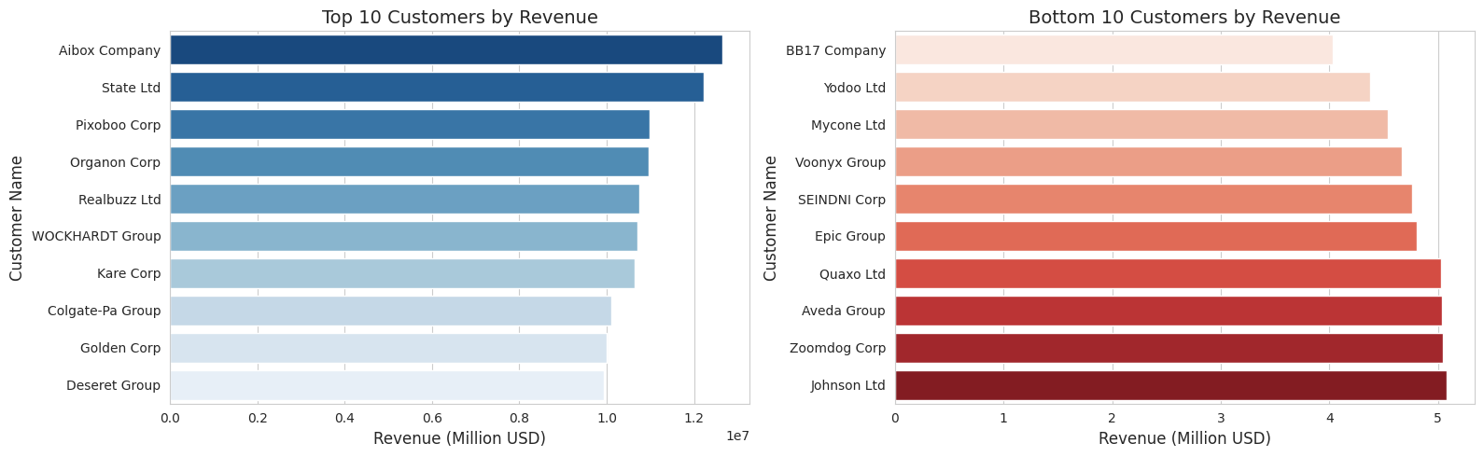
Top and Bottom 10 Customers by Revenue
Insights
Aibox Company leads significantly as the top revenue generator.
Bottom 10 customers generate substantially less revenue (around $4-5M).
Revenue concentration: Top customers drive a disproportionate share.
Large gap: Exists between the revenue of top and bottom tier customers.

Slide 13
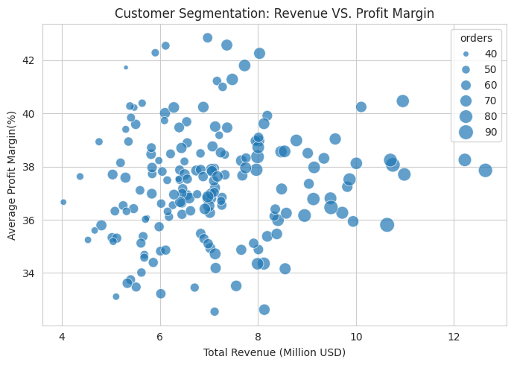
Customer Segmentation: Revenue vs. Profit Margin
Insights
Those Uniform 35–40 % margins confirm strong, consistent pricing and cost control.
>$10 M clients with <36 % margins reveal discounting hotspots—re evaluate large‑account terms.
$6–9 M clients with >40 % margins are high‑value candidates for targeted upsell.

Slide 14
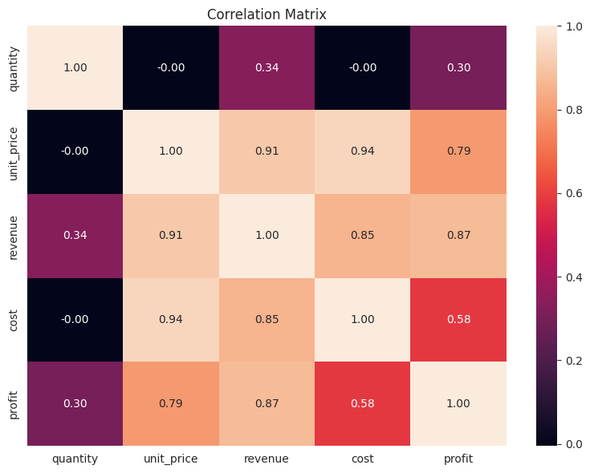
Correlation Heatmap of Numeric
Insights
Unit price is the primary driver, showing very strong correlations with cost (0.94), revenue (0.91) and profit (0.79).
Revenue & profit maintain a high link (0.87), underscoring direct profitability gains.
Quantity’s impact is minimal (≤ 0.34 vs. financials), indicating volume plays a secondary role.
Cost vs. profit correlation (0.58) is moderate, suggesting margin improvement focus should center on pricing.

Slide 15
Key Insights

Slide 16
Key Insights
Pronounced Seasonality: January revenues average $124 M, dipping to $95 M in April.
SKU Concentration: Products 26 & 25 together drive ~25 % of total sales.
Channel Trade‑Off: Wholesale captures 54 % of volume; Export leads with ~38 % average margin.
Geographic Dominance: California alone logs 7.6K orders ($230 M); the West region shows the largest swings.
Aibox Company and State Ltd are the most valuable customers in terms of Revenue.

Slide 17
Recommendations

Slide 18
Recommendations
Seasonal Promotions: Launch recovery campaigns in April and amplify January offers to smooth revenue swings.
SKU Optimization: Double down on top products 26 & 25 and re-evaluate pricing or phase out low‑margin SKUs.
Channel Expansion: Incentivize Export partnerships for high margins and introduce volume deals in Wholesale.
Regional Investment: Replicate California’s success in other regions and boost marketing in the Northeast & Midwest.
Margin Monitoring: Flag orders below 80 % margin and analyse cost drivers to uplift underperforming segments.

Slide 19
Dashboard Preview

Slide 20
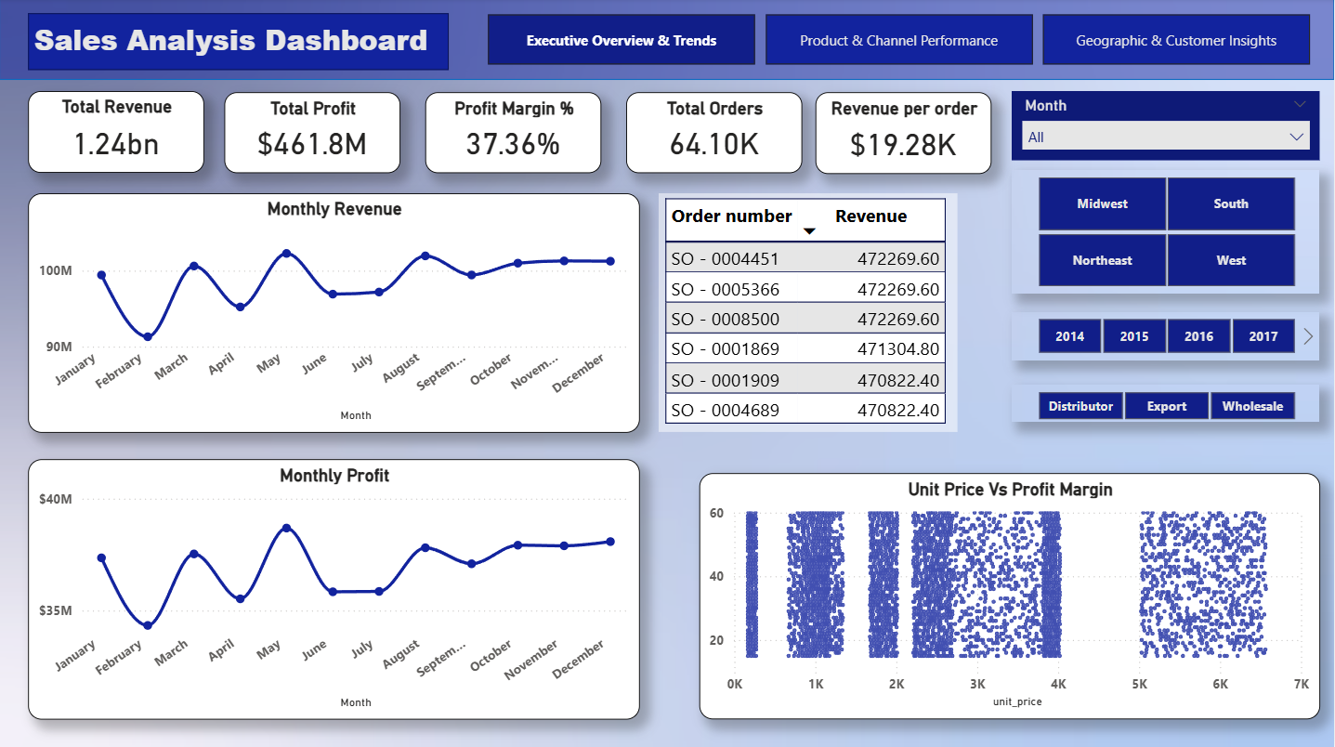
Page 1 – Performance Summary

Slide 21
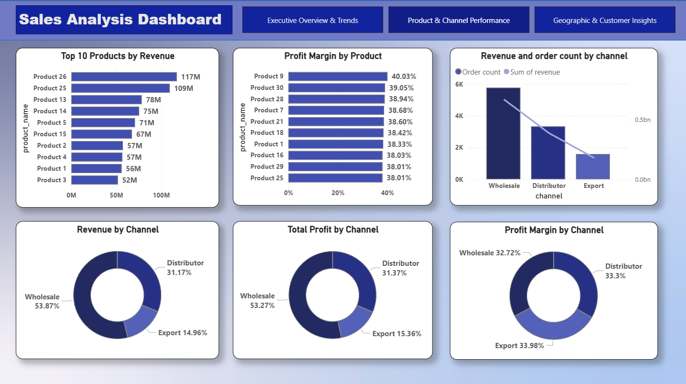
Page 2 – Customer Segmentation

Slide 22
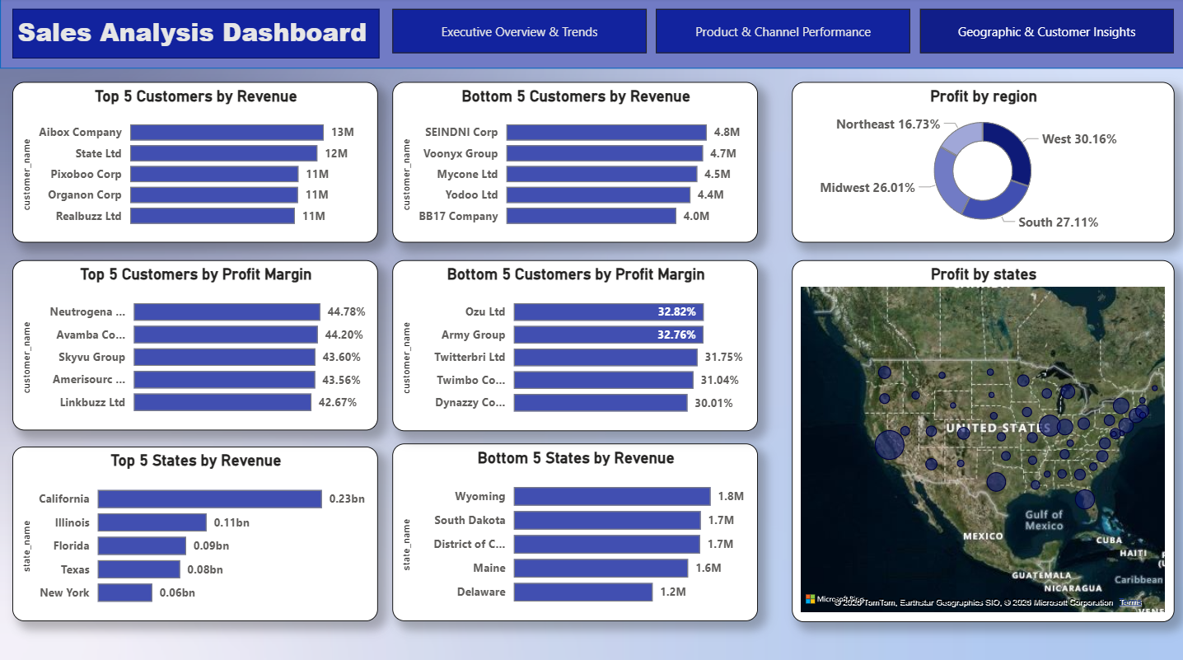
Page 3 – Revenue Scenarios

Slide 23
Conclusion

Slide 24
Conclusions
The analysis shows that overall sales performance is stable, with revenue primarily driven by pricing rather than volume. Business performance is concentrated among key products, customers, and regions, while profit margins remain consistent across segments. These insights highlight opportunities to improve growth by expanding underperforming areas and reducing dependency on top contributors.

Slide 25

Thank you !

